Slide 1



IPv6 Prospectus
Current status, projections, example deployment options
James R. Small, Sr. Architect
Notes:
Who am I?
What’s my background?
Why do I think I’m qualified to talk about IPv6?
I do not speak for or about my employer.
IPv4 is the walled garden because of CGN
IPv6 is the future frontier taking us into the future

Slide 2

presentation Objectives
Overview of Current Industry Landscape
IPv6 Deployment Considerations
Q&A throughout, I may postpone questions until the end depending on time

Slide 3
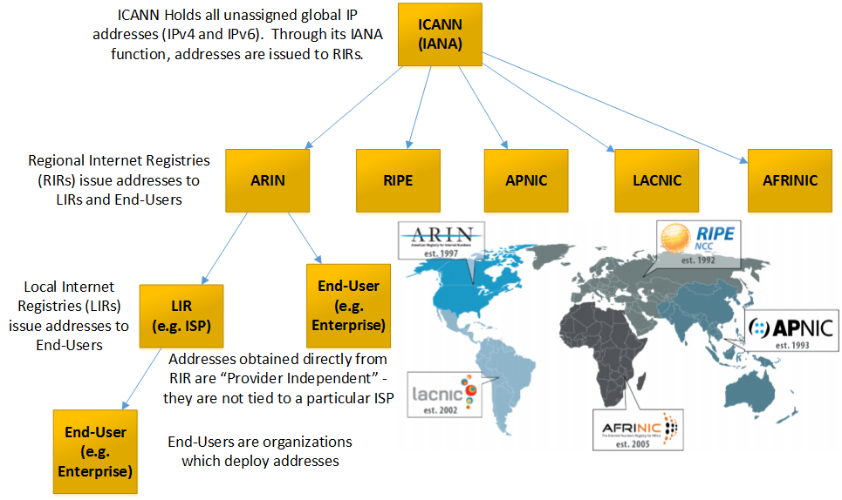
Planned IP Address Life cycle
Notes:
Starting time ~ 2.2 minutes
Who is ICANN? (Internet Corporation for Assigned Names and Numbers, oversees among other Internet resources, DNS and Addressing)
What is IANA? (Internet Assigned Numbers Authority is the part of ICANN that manages addressing)
Which RIR represents the US?
Why would an organization get an IP block directly from a RIR versus an ISP?

Slide 4
IPv4 Allocation
 | /8s | Number (Billions)
Total | 256 | 4.29
Usable | 220.77 | 3.70
RIR Pool | 3.64 | 0.06
Allocated | 217.13 | 3.64
Advertised | 168.11 | 2.82
10.0.0.0/8 –or- 10.0.0.0 255.0.0.0 is one /8
Notes:
Starting time ~ 4.4 minutes
How is an IPv4 address composed?
What is a /8?
Why are only 220.8 /8s usable? (Can’t use 0, 10—and other private networks, 127, multicast—224-239, class E—240-255 and a few other reserved/test prefixes)
What is the difference between allocated and advertised?
Why would someone own an address block and not advertise it?

Slide 5

Address Allocation drivers
World Population
Almost 7.4 billion and growing
Global Internet Population Penetration
Over 43% and steadily growing
Global Cellular/Mobile/M2M Connections
Over 7.6 billion and growing
The Internet of Things
4.9 billion as of end of 2015 (Gartner)
25 billion by 2020 (Gartner)
Notes:
Starting time ~ 6.6 minutes
What is M2M?
What is IoT?
25 billion by 2020 means devices online or network accessible

Slide 6
IoT device Growth
Year | Units (Billions)
2012 | 17.3
2013 | 16.1
2014 | 18.6
2015 | 20.9
2016 | 23.0
2017 | 23.9
2018 | 25.2
2019 | 27.3
From the McClean Report 2015, IC Insights’ analysis of IC industry
Notes:
Starting Time Target ~ 9 minutes
Internet of Things devices have a microcontroller to manage sensors and actuators
By 2020, Gartner predicts the cost to have integrated networking will fall to $1/unit or less. Based on these costs projections, Gartner further predicts that all microcontroller assemblies will come with integrated networking. This doesn’t mean the networking is necessarily always used or activated, only that it’s present as an option. However, the general expectation is that a large percentage of these will use networks in some fashion.
Who uses microcontrollers? (lead)

Slide 7
Does iot have practical uses today?
Solution Areas | Example Applications
Energy and Utilities | Smart Meters, SmartGrids
Building Automation | Demand Response, HVAC, Lighting, Surveillance, Security
Transportation | Connected Vehicles, Public Transportation, Freight & Containers, Logistics & Tracking
Retail | Vending Machine, PoS, Scanners, Kiosks
Healthcare | Medical Equipment, Remote Monitors, EHR Access, eOutpatient Care, Assisted Living, eHospital
Manufacturing | Industrial Process Control, PLC, Diagnostics, Energy Use Management
Notes:
Starting time ~11.2 minutes
Also Water/Waste Water management, Gas line management

Slide 8
But…
Registry | Depletion Date | Available /8s | Status
IANA | Feb-2011 | 0 | Exhausted
APNIC | Apr-2011 | 0.6284 | Depleted
RIPE NCC | Sep-2012 | 0.9520 | Depleted
LACNIC | Jun-2014 | 0.1144 | Depleted
ARIN | Sep-2015 | 0 | Exhausted
AFRINIC | Jul-2017 (Est) | 1.9496 | Normal
One /8 is 16,777,216 IPv4 addresses
Notes:
Starting time ~13..4 minutes
What’s the difference between exhausted and depleted?
What does depleted mean in terms of policy?
ARIN’s waitlist is currently at 247

Slide 9
Context
 | 2005 | 2006 | 2007 | 2008 | 2009 | 2010 | 2011
Allocated (millions) | 174.4 | 168.1 | 203.9 | 203.3 | 189.4 | 248.8 | 201
Alloc /8s | 10.4 | 10 | 12.2 | 12.1 | 11.3 | 14.8 | 12.0
Notes:
Starting time ~15.6 minutes
What does the Red line at the bottom going to zero mean? (IPv4 allocation)
What does the Orange line going steadily up mean? (6% annual growth – IPv4 projected demand with sufficient supply)
What does the Brown line crossing the red line and going into the orange line mean? (IPv4 address deficit because IANA and RIRs unable to meet demand)
What does the Blue line at the top going down mean? (Unadvertised space, estimating growth of 18%/year to offset RIR exhaustion)
How many organizations will be willing to sell rights to their unadvertised address space?
This doesn’t show ISP reserves, how long will they last? Telstra, the largest ISP in Australia run out in March of 2015 – are more ISPs next?
How long can CGN sustain ISPs for?
A common question/comment I hear is if so and so returned their /8, everything would be fine. How many /8s were we going through/month going back 5 years? In addition, once we cover address markets you will see why no one will be willing to give away their address space.

Slide 10
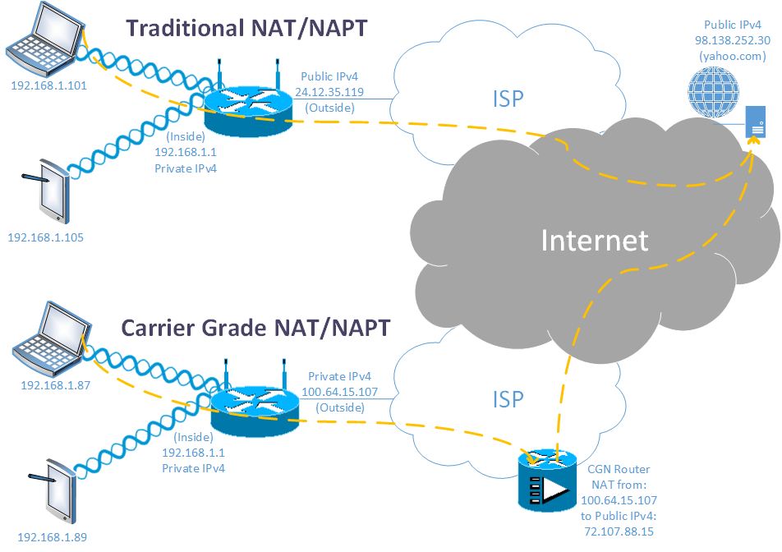
IPv4 tactics and strategy
Short Term - Preserve IPv4 with CGN
Notes:
Starting time ~17.8 minutes
Becoming more and more common on wireline residential connections
The norm for cellular connectivity
With CGN, end user cannot host any services – this breaks some consumer products!
CGN makes user-to-user communication challenging, typically requires STUN/TURN relay

Slide 11
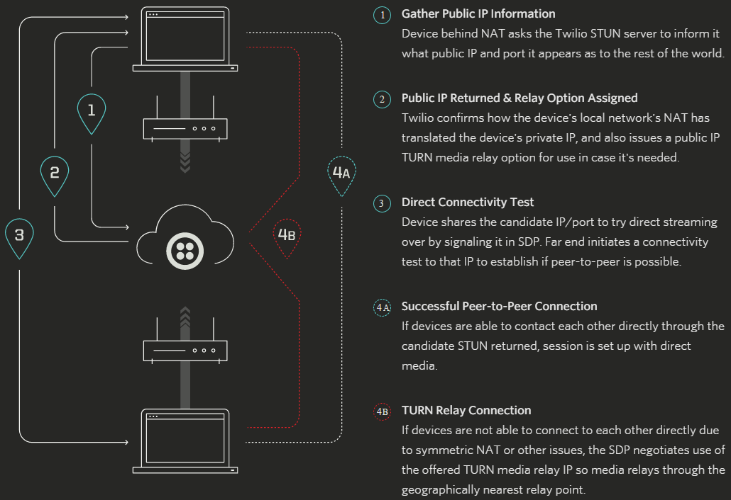
Impact of IPv4 exhaustion
Wide spread CGN Deployment
Security challenges – One IPv4 address no longer maps to a user/location, could be an entire neighborhood/area
Makes some communications challenging – Generally doesn’t work with online gaming
Twilio STUN/TURN Service
Notes:
Starting time target ~ 20 minutes
Another issue, authentication can’t embed IP addresses, still see this in some applications
There are costs to preserving IPv4 – CGN generally requires the use of a TURN Relay for any user-to-user communication such as Voice and Video. Relaying all traffic through a site is an expensive proposition – bandwidth is a significant cost. It also requires over double the bandwidth to be a man in the middle.

Slide 12
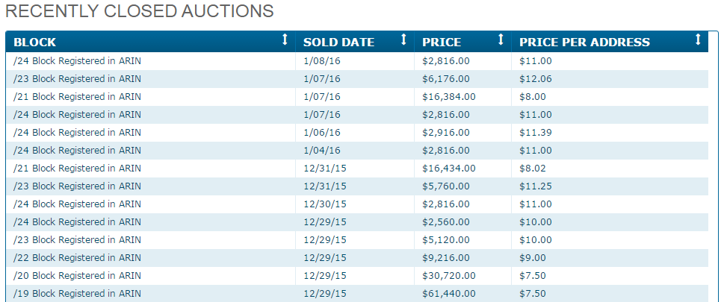
IPv4 tactics and strategy
Short Term - Maintain Adequate IPv4 Reserve
New IPv4 blocks through Address Markets
IPv4Auctions.com
Notes:
Starting time ~22.2 minutes
What if CGN isn’t enough or more addresses are needed?
Why aren’t ISP IPv4 blocks an option for some organizations?
How long will the addressing markets extend the life of IPv4?
Why is a /24 the smallest block/longest prefix shown?
Are there risks to buying an IPv4 address?
How do I prevent someone else from advertising/using my address?
Long term strategy is… (drum roll!)
What about an alternative to IPv6 or changing IPv4? How long would it take?

Slide 13
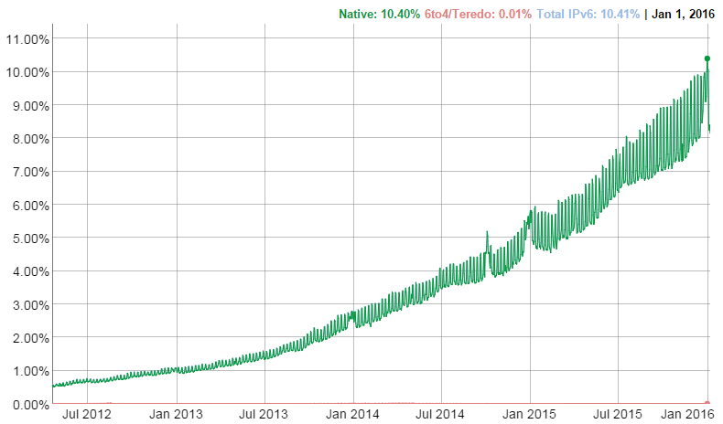
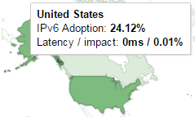
IPv6 Story – Google
Evaluating IPv6 Adoption in the Internet
Notes:
Starting time ~24.4 minutes
How does Google measure IPv6? Is it an end-to-end test? (JavaScript runs on client to test connecting to IPv4 and IPv6 resources)
It’s worth mentioning that Facebook sees a higher percentage of IPv6 users than Google

Slide 14
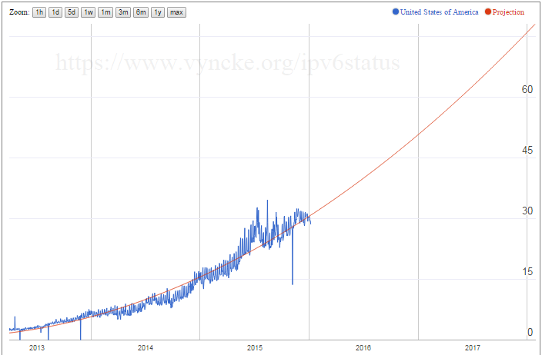
IPv6 Story – US (APnic labs)
APNIC Labs IPv6 Measurement System
Changes to the Way We Measure IPv6
Notes:
Starting time ~26.6 minutes
Who is APNIC Labs?
How do they measure IPv6? They use ads? (Ads distribute JavaScript/Flash/HTML5 to test browser connectivity to IPv4/IPv6 resources)
Who funds their research? (Google!)

Slide 15
IPv6 Story – Akamai vs. apnic labs
Rank | IPv6% | Country
1 | 37.5 | Belgium
2 | 22.2 | Switzerland
3 | 21.4 | Portugal
4 | 20.4 | Greece
5 | 20.2 | Germany
6 | 18.2 | Peru
7 | 16.7 | US
8 | 15.6 | Luxembourg
9 | 12.3 | Ecuador
10 | 10.8 | France
Rank | IPv6% | Country
1 | 49.8 | Belgium
2 | 29.7 | US
3 | 29.1 | Switzerland
4 | 28.8 | Germany
5 | 24.8 | Portugal
6 | 20.8 | Greece
7 | 20.2 | Luxembourg
8 | 17.3 | Estonia
9 | 16.8 | Peru
10 | 16.4 | Japan
Notes:
Starting time ~ 29 minutes
What is a CDN?
Who is Akamai?
Why is there a discrepancy between Akamai and APNIC Labs?
Who is the best source between Google, Akamai and APNIC Labs?

Slide 16
what constitutes critical mass?
Penetration in US (APNIC Labs):
Current number of (est.) IPv6 Internet Users in US:
84,414,764
(Est. US Internet Users: 280,687,714)
(Est. US Population: 323,000,822)
Aggressive | 10% penetration
Moderate | 15% penetration
Conservative | 20% penetration
Today | 30%
December, 2016 | 50%
August, 2017 | 67%
February, 2018 | 80%
Notes:
Starting time ~31.2 minutes
How high should adoption be before you deploy IPv6?
How long will it take you to plan and deploy IPv6?
How long until someone comes up with a key innovation (killer app) which is IPv6-only? That’s the million dollar question!

Slide 17
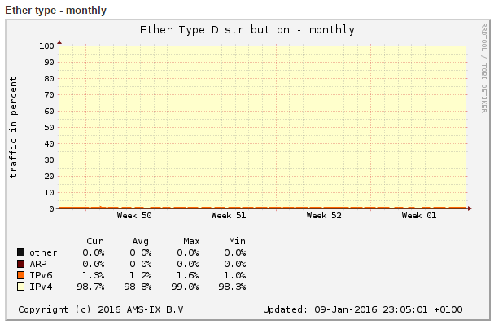
Penetration different from volume
Amsterdam Internet Exchange – One of the world’s largest
Notes:
Starting time ~33.4 minutes
Some cold water!
What’s an Internet Exchange?
Who is the Amsterdam Internet Exchange?
How big is it?

Slide 18
IPv6 Story – Major US ISPs (users)
US Broadband Rank | ISP | IPv6 Deployment %
1 | Comcast | 41.9
2 | AT&T | 52.4
3 | Time Warner Cable | 23.6
4 | Verizon | ?
5 | CenturyLink | 0.1
US Cellular Rank | ISP | IPv6 Deployment %
1 | Verizon Wireless | 71.4
2 | AT&T Wireless | 6.1
3 | T-Mobile USA | 53.2
4 | Sprint Wireless | 9.7
(Satellite) | Hughes Network Systems | 24.9
Notes:
Starting time ~35.6 minutes
A simple Internet view is users go through ISPs to access services and content
Within the US, what’s the story for end user adoption?
What about smaller ISPs and Cellular companies?

Slide 19
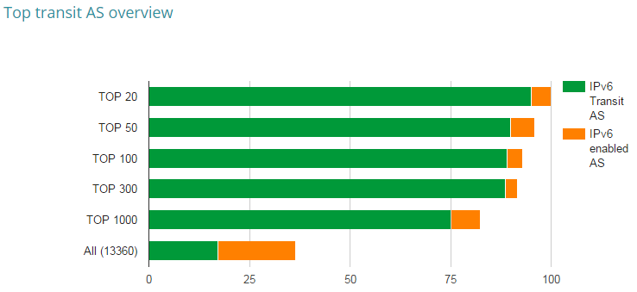
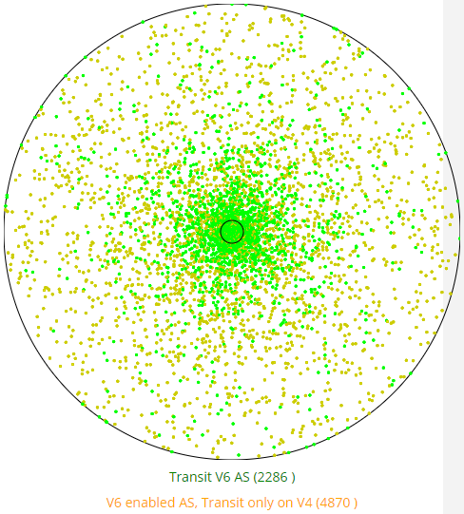
ipv6 story – Top Global ISPs (internet)
Cisco 6lab
Notes:
Starting time ~37.8 minutes
Next, what’s the ISP view look like?
What is an AS?
What is transit/transiting?
What is the significance of the top 20/50/etc?
What’s the circle in the lower right?

Slide 20
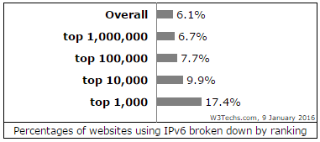
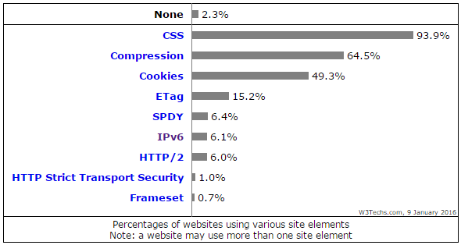
ipv6 view from the web (content)
W3Techs Web Technology Surveys – Site Elements
Notes:
Starting time ~ 40 minutes
Finally, what’s the content vantage point for IPv6?
Who is W3Techs and what is this?
What’s a site element?

Slide 21






















Who is deploying IPv6?
Silicon Valley/Technology leaders have long since deployed IPv6, also:
Operating System Vendors
Networking Vendors
Security
Common Sites and Services
Notes:
Starting time ~42.2 minutes
Facebook moving to IPv6-only internal network
Silicon Valley – Twitter is an exception
Operating Systems - Ubuntu is a notable exception for operating system vendors – but fits in with cloud adoption
Security - Symantec is an exception
Common Sites – Ebay is an exception

Slide 22


















Who is Not deploying IPv6?
But Missing…
Cloud
Compute
Storage
Mainstream Sites
Service Sites
Smaller sites
Notes:
Starting time ~44.4 minutes
Cloud (IBM Softlayer is exception here)
Amazon – can work around with ELB
Azure – supposedly working on it…
Google Compute Engine is IPv4-only, some limitations with IPv6
Compute – AMD also missing
Storage
Mainstream Sites
Service Sites
Smaller sites

Slide 23

Why the reluctance with ipv6?
Interface change
Invisible infrastructure (electric grid)
Inertia
Limited short term benefits
Notes:
Starting time ~46.6 minutes
IP as interface - US Analog TV transmission, 2009; but no global Internet governance body to mandate/facilitate transition
Part of the problem is the original socket API didn’t hide addressing from applications; thus any addressing change often requires application changes making the transition challenging
IP as plumbing – Think electric grid problems, no one cares until outages/service disruptions
We’ve “always” done it this way
Limited immediate gain; a bit of a tragedy of the commons; although there are some benefits

Slide 24
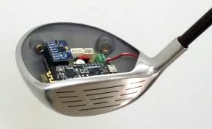
IPv6 Drivers
The Internet of Things
Mobility - Facebook findings from their @Scale Conference (September, 2015)
10% of global users connect to them with v6
23% of US users connect with v6
33% of Mobile US users connect with v6
45% of 4G Mobile US users connect with v6
With client instrumented A/B testing (mobile focus), IPv6 is consistently about 15% faster than IPv4 across carriers
Analysis done by Facebook data scientist
Two sample sizes of over 155,000
More than 1/3 of US Mobile Traffic is IPv6 and still growing…
Maximum control of user experience
Notes:
Starting time ~ 49 minutes
IoT is steadily ramping up and the major consortiums including the AllSeen Alliance, Industrial Internet Consortium, Thread Group, Open Interconnect Consortium and IPSO Alliance all believe IPv6 is it. This is an interesting area to watch.
The majority of users connect to Facebook using mobile devices – so Facebook is very interested in IPv6; the suspicion is that CGN is causing the performance degradation but nothing conclusive
What about control of the user experience?

Slide 25
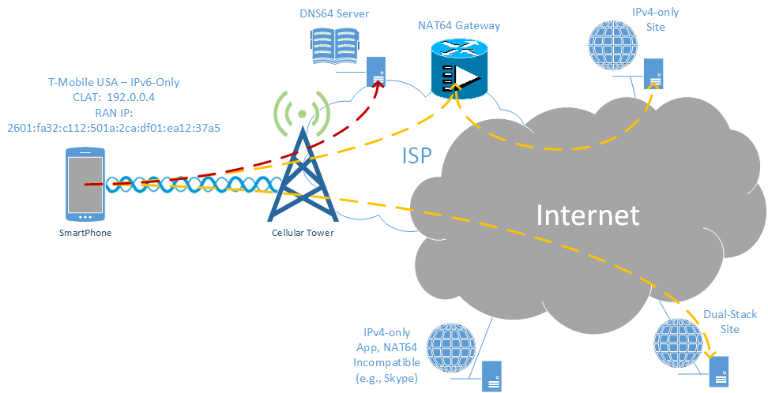
ipv6-only, nat64, 464xlat
The User Experience – Control, Visibility, Performance
Notes:
Starting time ~51.2 minutes
What happens as IPv6-only connections become more common?
For now, all IPv6-only connections I know of provide NAT64 and 464XLAT
Internet site/app has IPv6 address – direct connectivity
Internet site/app is IPv4-only
First must synthesize a fake IPv6 address via DNS64 (takes time)
Take some time to explain DNS64
Next, mobile device uses synthesized address which routes it to NAT64 gateway (takes time)
Refer back to Facebook study of mobile performance and IPv6
What if site/app doesn’t work through NAT64, such as Skype? Carrier must make special provision to use 464XLAT. Essentially handset configured to route IPv4-only app through CLAT interface which fakes a local IPv4 address. This is then translated to IPv6 and sent to the NAT64 gateway. This only works if carrier provisions it and still doesn’t fix all IPv4-only apps.
How do you know if your app/site works through NAT64? Only with thorough testing…
Originally it was feared there would be IPv6-only connections that didn’t have access to IPv4 Internet. Hasn’t happened yet, but once adoption reaches a certain point its possible. Hard to predict…
All of this relates to the user experience
If you don’t support IPv6 for your Internet facing apps/services, you risk problems
First of all – you don’t have control of how well connectivity works. It depends on how well the DNS64 and NAT64 services work. The carrier has little motivation to tune this to improve your site/app responsiveness. If DNS64 and/or NAT64 service are down, degraded, reboot, etc. it impacts you.
Second, you have no visibility into end user address. You can only connections from the NAT64 gateway. This make troubleshooting and correlation harder. If your app requires special provisioning, application fixups or anything else, you’re out of luck unless you control the translation such as running your own SLB64 load balancer.
Finally, using DNS64 and NAT64 take time – again, refer to the Facebook study. Optimal performance when you support native connectivity with no 3rd party services/gateways.

Slide 26

presentation Objectives
Overview of Current Industry Landscape
IPv6 Deployment Considerations
Notes:
Starting time ~53.4 minutes

Slide 27
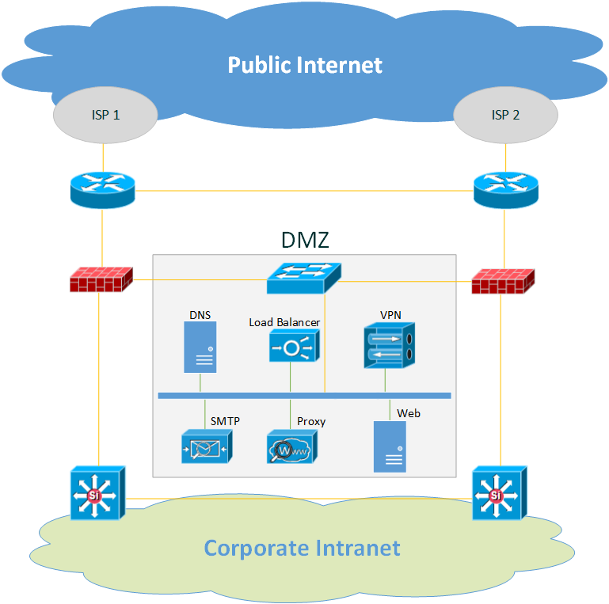
example organization perimeter
Notes:
Starting time ~55.6 minutes
How to bring IPv6 into your organization
Start with your ISP connection
Need to work with your ISP to provision
May need to setup BGP – it can support IPv4 and IPv6 with MP-BGP Address Families
If you’re running an IGP, it will also need to be setup for IPv6
OSPF or OSPFv2 is IPv4-only, can add OSPFv3 for IPv6 but separate IGP
EIGRP should be run in named mode using address families
Next add IPv6 to your firewalls
Configure at least one DMZ network or VLAN which is dual stack
Most switches transparently support IPv6 within a VLAN/network but check if there are any special requirements
Within the DMZ, begin supporting IPv6 services
Start with DNS
Next add your load balancer to front end IPv4-only applications via SLB64
Next add user/site-to-site VPN services
Next add proxy services for IPv6-only Internet sites/services
Consider adding E-mail support with an SMTP gateway
If necessary/desired add web sites/applications
IPv6 can be brought into the corporate Intranet if desired, but often this isn’t required – an edge solution should be sufficient for now

Slide 28

a word of caution
When you enable IPv6 – most modern services will automatically listen on all IPv4 and IPv6 addresses
Often times your network services are restricted by address-based access control:
SNMP (network management)
VTY (telnet/ssh access)
HTTP/HTTPS (web/REST/API)
FTP (file transfers)
NTP (time synchronization)
By default, these services will accept connections from anywhere on the IPv6 Internet which may not be what you want…
Notes:
Starting time ~57.8 minutes

Slide 29

ships in the night
Remember – IPv4 and IPv6 are ships in the night!
They are completely independent protocols
Blocking all IPv4 has no effect on IPv6 and vice versa.
Notes:
Starting time ~60 minutes
Ships in the night or in other words, IPv4 and IPv6 don’t intersect just like the passengers on two passing ships don’t interact
This is important to remember across the board
True at layer 2 – IPv4 and IPv6 have different frame types
True at layer 3 – IPv4 and IPv6 have different protocol numbers
True for security, QoS, routing, etc…

Slide 30




ipv6 easy button
Need to publish your content via IPv6 but don’t want to do anything?
Use a CDN! (Content Distribution Network)
Many companies use CDNs for IPv6
Popular CDNs offering IPv6 to IPv4 translation:
Akamai
Limelight Networks
CloudFlare
Edgecast
Notes:
Starting time ~ 62.2 minutes
What is a CDN?
CloudFlare is popular for many prominent blogs and also used by the IETF!

Slide 31


linux/open source ipv6 Tools
Routing (BGP/OSPF) – Quagga (used by Cumulus)
GoBGP, ExaBGP, BIRD, OpenBGDd, BaGPipe BGP
Load Balancing (Application Delivery Control) – HAProxy
Nginx, LVS, Balance, Varnish
Proxy – Squid (Forward/Reverse/Caching/Security/Content Filter/Authentication)
Varnish, Nginx, IPFire, Apache, Artica
Others
DNS – BIND, PowerDNS
E-mail – Postfix or Exim (Extra time – sendmail ;-)
Firewall – IPTables (IP6Tables)
VPN – OpenVPN
Notes:
Starting time ~ 64.4 minutes

Slide 32

demo
IPv4-only Web Site/Application
Using NGINX in Docker Container for example
Translate from IPv6 to IPv4 (SLB64) using HAProxy
Utility of IPvFoo (Chrome)
Also IPvFox for Firefox
Notes:
Starting time ~ 66.6 minutes

Slide 33
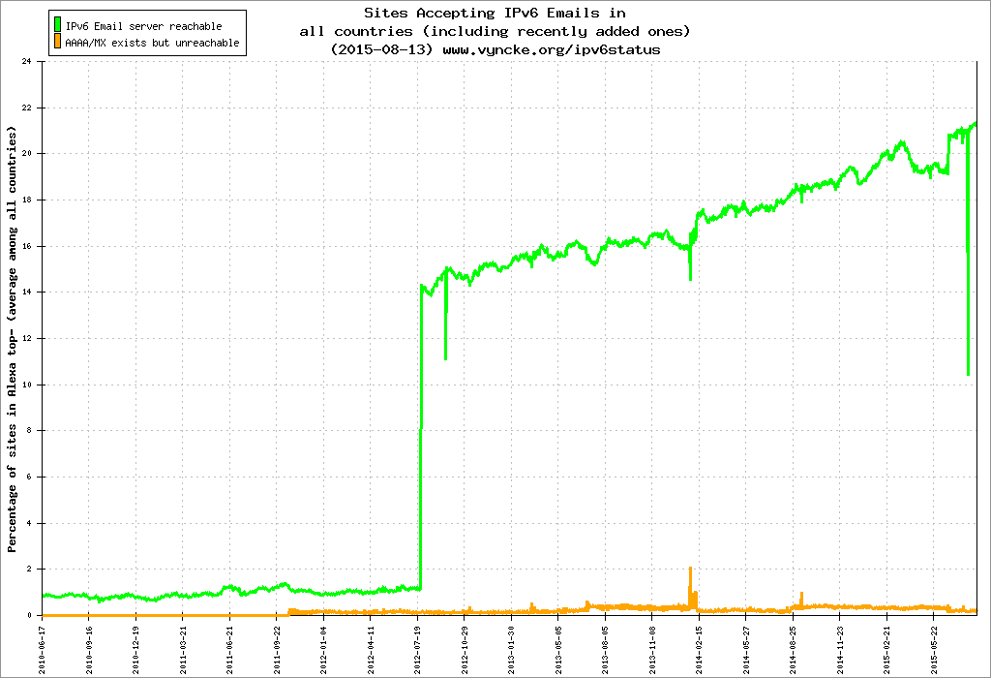
state of ipv6 internet email
From the Alexa top 500 Internet sites, approximately 21% of them support inbound IPv6 E-mail
Notes:
Starting time ~ 68.8 minutes
Looking at the top E-mail providers for the US – Google (including Gmail), Yahoo, Hotmail (including Live Mail and Outlook Mail), AOL and Comcast – Only Google and Comcast support IPv6 E-mail and only in the inbound direction
IPv6 E-mail security (especially anti-SPAM and reputation-type protection) appears to be in the late innovators/very early adopters phase
The Messaging, Malware and Mobile Anti-Abuse Working Group published a policy paper on issues receiving email over IPv6 in September, 2014 which discusses several challenges with IPv6 transported email. A large portion of spam is blocked by IP reputation with IPv4. However, given the magnitude of address size for IPv6, this isn’t possible. Because blocking IPv6 based spam is still a developing area, the paper recommends further research, standards body work and caution with deployment.
Furthermore, from the Cisco Live conference in Australia (BRKSEC-3770) on Advanced Email Security in 2015, it states they measure IPv6 transported SMTP traffic at 2-3% of total volume
Therefore while investigating support of email over IPv6 is recommended, deployments beyond proof of concept or testing may be premature

Slide 34
can’t nat fix everything?
# | Source | Destination | Stateful | Stateless | Use Case
1 | IPv6 Network | IPv4 Internet | Yes | Yes | SmartPhone
2 | IPv4 Internet | IPv6 Network | Static Mappings | Yes | IPv6-only Lab Access
3 | IPv6 Internet | IPv4 Network | Yes | No | SLB64 Preferred
4 | IPv4 Network | IPv6 Internet | No | No | *
5 | IPv6 Network | IPv4 Network | Yes | Yes | Intra-Org
6 | IPv4 Network | IPv6 Network | Static Mappings | Yes | Intra-Org
7 | IPv6 Internet | IPv4 Internet | No | No
8 | IPv4 Internet | IPv6 Internet | No | No
RFC 6144 – Framework for IPv4/IPv6 Translation
Notes:
Starting time ~ 71 minutes
This matrix shows what stateful and stateless NAT64 can do
SLB64 is generally preferred for this as it acts like a reverse proxy and prevents MTU mismatch problems, NAT64 can result in MTU black holes
NAT46 can be useful in some cases such as for NAT friendly apps like RDP (access IPv6-only PC from IPv4 network with NAT64)
*NAT-PT supports this but was deprecated because of poor performance and scalability; in general because of magnitude differences between IPv4 and IPv6, no viable techniques to handle unlimited IPv6 address translation

Slide 35

what about the application space?
Network challenges and complexities are fairly well understood
Notes:
Starting time ~ 73.2 minutes

Slide 36
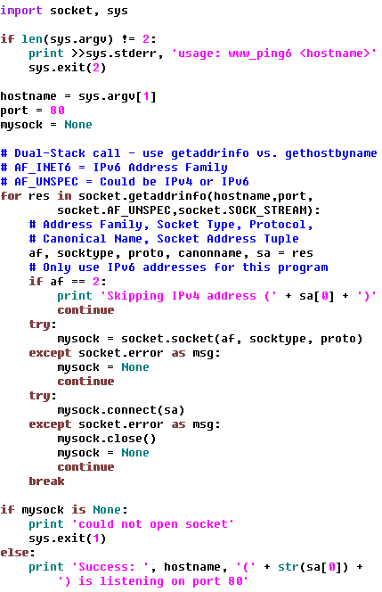
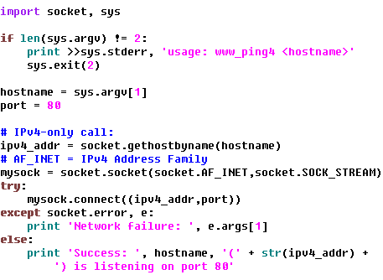

ip socket code
Legacy, IPv4-Only Code:
Dual-Stack Code:
Notes:
Starting time ~ 75.4 minutes
This isn’t elegant or recommended code! It’s just a basic illustration of using the socket API.
Classic IP code often uses gethostbyname or other IPv4-only functions
Modern code should use getaddrinfo which deals with both IPv4 and IPv6
Unlike gethostbyname, getaddrinfo returns a list of possible addresses sorted by Operating System preference. Typically IPv6 is preferred and put at the front of the list, but this can be changed with prefix policies.

Slide 37

apple’s audit for IPv4-only code
iOS apps must support IPv6-only connections as of version 9
What causes apps to be IPv4-only?
IPv4-only storage objects:
uint32_t, in_addr, sockaddr_in
IPv4-only APIs:
inet_aton, gethostbyname
IPv4-only usage of an API:
gethostbyname2(hostname,AF_INET)
Pre-flight checks before connecting:
Checking if device has an IPv4 address
Checking for reachability to 0.0.0.0
Note: This is also why iOS doesn’t and won’t support 464XLAT – instead Apple forces you to support IPv6 or NAT64
Notes:
Starting time ~ 77.6 minutes

Slide 38

apple’s recommendations to support ipv6
Create address-family agnostic code
Connect without pre-flight check:
If connection succeeds, great
If connection fails, handle gracefully
Use higher-layer networking frameworks
NSURLSession and CFNetwork-layer APIs
See RFC 4038, Application Aspects of IPv6 Transition
Connect-by-Name APIs
Notes:
Starting time ~ 80 minutes
For example:
In Python, uses the requests library instead of the socket library for web traffic
In Java, the standard socket call is address family neutral
Where sockets must be used, try to code in an address family independent manner

Slide 39

Questions
?

Slide 40
Appendix
Notes:
Should be here around 35 minutes

Slide 41
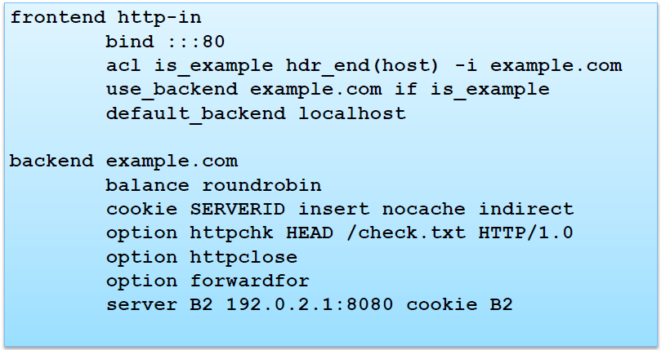
Example Software Proxy
HAPROXY
Example configuration (/etc/haproxy.cfg):
From Andrew Yourtchenko’s Cisco Live Preso (BRKRST-2304)

Slide 42
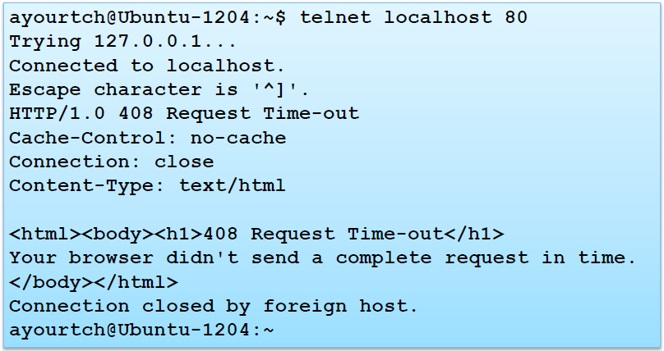
Example Software Proxy
HAPROXY – Connection Timeouts:
From Andrew Yourtchenko’s Cisco Live Preso (BRKRST-2304)

Slide 43
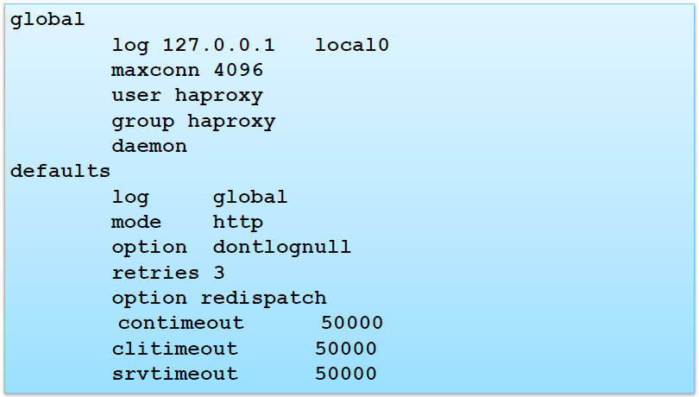
Example Software Proxy
HAPROXY – Connection Timeouts, test the defaults!
From Andrew Yourtchenko’s Cisco Live Preso (BRKRST-2304)

